Slide 1
INTRUSION DETECTION SYSTEM and honey pots
-SS19CO002

Slide 2
What is intrusion?
Computer intrusions occur when someone tries to gain access to any part of your computer system.
This intrusion is done by intruders.
  Outside Intruder (Masquerader)
  Inside Intruder (Misfeasor)

Slide 3
Intruders can:
Access your computer to view, change, or delete information on your computer.
Crash or slow down your computer.
Access your private data by examining the files on your system.
Use your computer to access other computers on the Internet.

Slide 4
Intrusion detection system
An intrusion detection system (IDS) is a device or software application that monitors a network for malicious activity or policy violations and issues alerts when such activity is discovered.
Malicious violations and ventures are reported:
  To administration
Some IDS’s are capable of responding to detected intrusion upon discovery. These are classified as intrusion prevention systems (IPS).

Slide 5
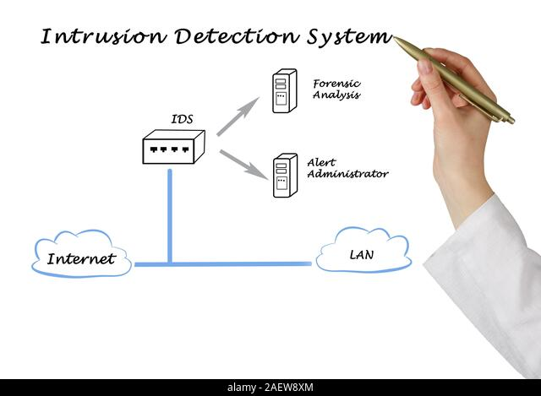

Slide 6
Type of intrusion detection systems
we Mainly have two types of Intrusion detection system:
  1)Network based intrusion detection system
  2)Host based intrusion detection system.

Slide 7
Network based intrusion detection system
It is a Type of IDS based in network system.
what is network traffic?
Network traffic is the amount of data moving across a computer network at any given time.
NIDS is an intrusion detection system that analyzes incoming network traffic
Detects the malicious data Present in the packets
  Captures the data
  And Analyze it.

Slide 8
Analysis in NIDS
NIDS matches the captured traffic with the library of known attacks
Library of known attacks : Collection or list pf all known attacks on a computer network
If match is found it means the intruder intended to do that specific attack on the system.
Once an attack is identified or abnormal behaviour is observed, the alert can be sent to the administrator.

Slide 9
Disadvantage of nids
Analysis very difficult in a busy network
NIDSs cannot analyze encrypted information.

Slide 10
Host Based Intrusion detection system
Installed on an independent hosts or devices on the network
monitors the incoming and outgoing packets from the device only
alerts the administrator if suspicious or malicious activity is detected.
How this malicious activity is detected in HIDS?

Slide 11
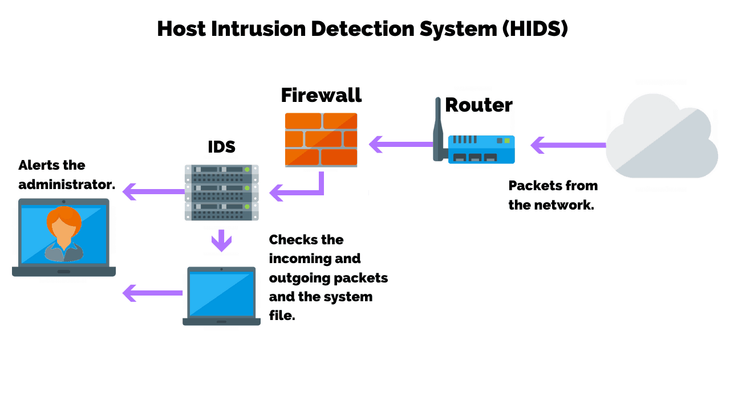
It takes a snapshot of existing system files and compares it with the previous snapshot. If the analytical system files were edited or deleted, an alert is sent to the administrator to investigate

Slide 12
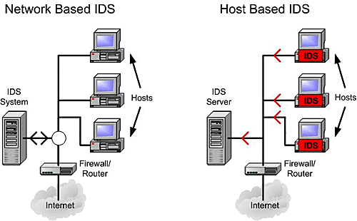

Slide 13
Example of NIDS:
An example of an NIDS is installing it on the subnet where firewalls are located in order to see if someone is trying crack the firewall.
Example of HIDS:
An example of HIDS usage can be seen on mission critical machines, which are not expected to change their layout.

Slide 14

HoneyPot
-A trap to lure attackers

Slide 15
What is a honeypot
It is a virtual trap to lure attackers.
A compromised computer system that allows attackers to exploit vulnerabilities
To study them and to improve security policies.
We can apply a honeypot to :

Slide 16
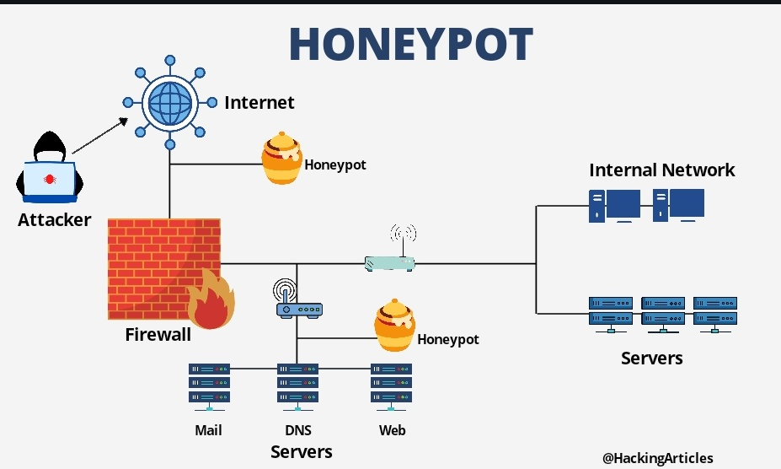
computing resource
Software
Networks
File servers
routers

Slide 17
Used to understand attackers behavior pattern
Security teams can use honeypots to:
  investigate cybersecurity breaches
  collect intel on how cybercriminals operate
  reduce the risk of false positives, when compared to traditional cybersecurity measures
intended to look like legitimate, vulnerable systems to attract cybercriminals.

Slide 18
Production vs. Research Honeypots
There are two primary types of honeypot designs:
Production honeypots—serve as decoy systems inside fully operating networks and servers, often as part of an intrusion detection system (IDS).
They deflect criminal attention from the real system to analyse malicious activity.
Research honeypots—used for educational purposes and security enhancement. They contain trackable data that you can trace when stolen to analyze the attack.

Slide 19
Types of Honeypot Deployments
Pure honeypots—complete production systems that monitor attacks through bug taps on the link that connects the honeypot to the network. They are unsophisticated.
Low-interaction honeypots—imitate services and systems that frequently attract criminal attention. They offer a method for collecting data from blind attacks such as botnets and worms malware.
High-interaction honeypots—complex setups that behave like real production infrastructure. They don’t restrict the level of activity of a cybercriminal, providing extensive cybersecurity insights. However, they are higher-maintenance and require expertise and the use of additional technologies like virtual machines to ensure attackers cannot access the real system.

Slide 20
Honey Pots limitations:
Cannot detect security breaches in legitimate systems
Does not identify the attacker.
After Successfully Exploiting honeypot an attacker can to infiltrate the real production network.

Slide 21
Honeynet
A Network of honeypots
contains one or more honeypots.
it looks like a real network and contains multiple systems

Slide 22
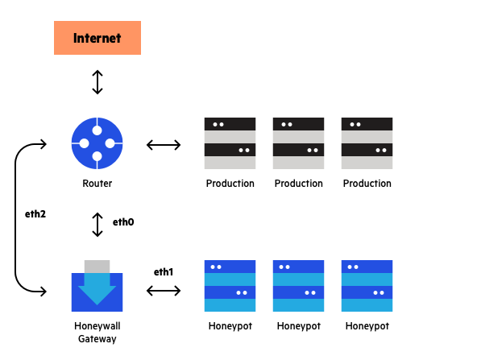

Slide 23
Advantages of Honeynet
it feels more like a real network, and has a larger catchment area.
better solution for -
large, complex networks – it presents attackers with an alternative corporate network which can represent an attractive alternative to the real one.

Slide 24
Thank you

